Slide 1
Shell Bootcamp 2024 3 Reflections for Week 1
Cherry Chopra
Date : 30-Aug-2024

Slide 2
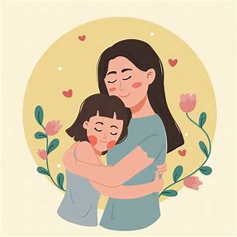
About Me
Everything happens for a reason.

Slide 3

My learnings from this week!

Slide 4
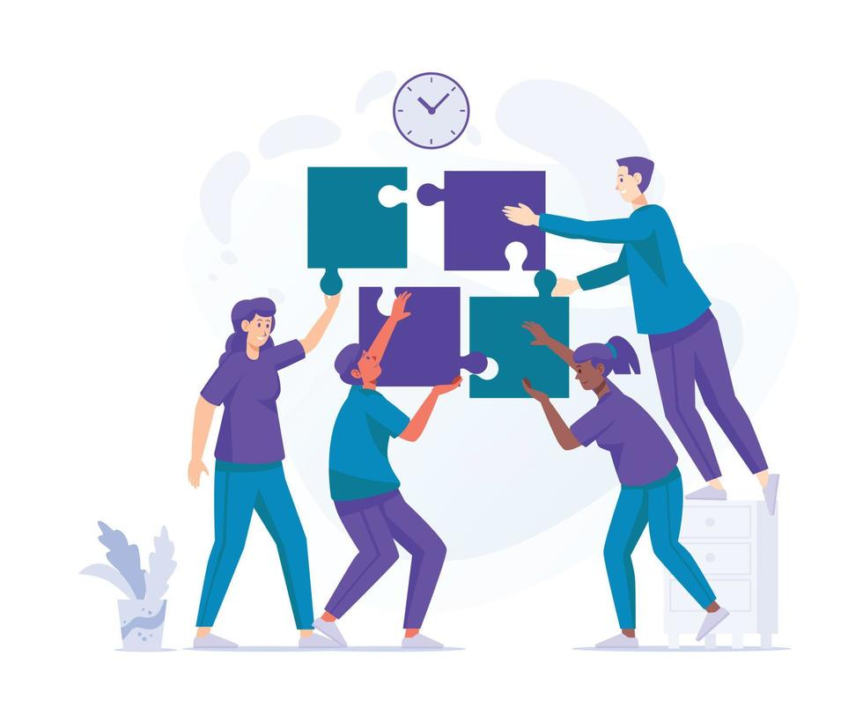
Learning 1 | My takeaways
Key learning:
Importance of team collaboration and teamwork.
Key takeaway:
Listening to others’ inputs and understanding their point of view to the solution and incorporating the best ideas from each team member strengthens the whole team’s performance and output.
How do I personally see this concept implemented in the Energy sector:
Effective collaboration between different teams ensures smooth and safe operation in the energy sector.

Slide 5
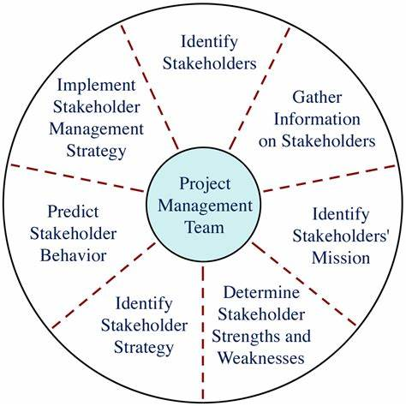
Learning 2 | My takeaways
Key learning:
Meeting & Call Etiquettes and Presentation Skills. Stakeholder Management.
Key takeaway:
Certain decorum that needs to be maintained in professional settings and how to catch the audience’s attention when making a presentation. Dealing with stakeholders in a professional manner.
How do I personally see this concept implemented in the Energy sector:
Useful when holding meetings with clients, customers and stakeholders to make an impact with attention to detail.

Slide 6
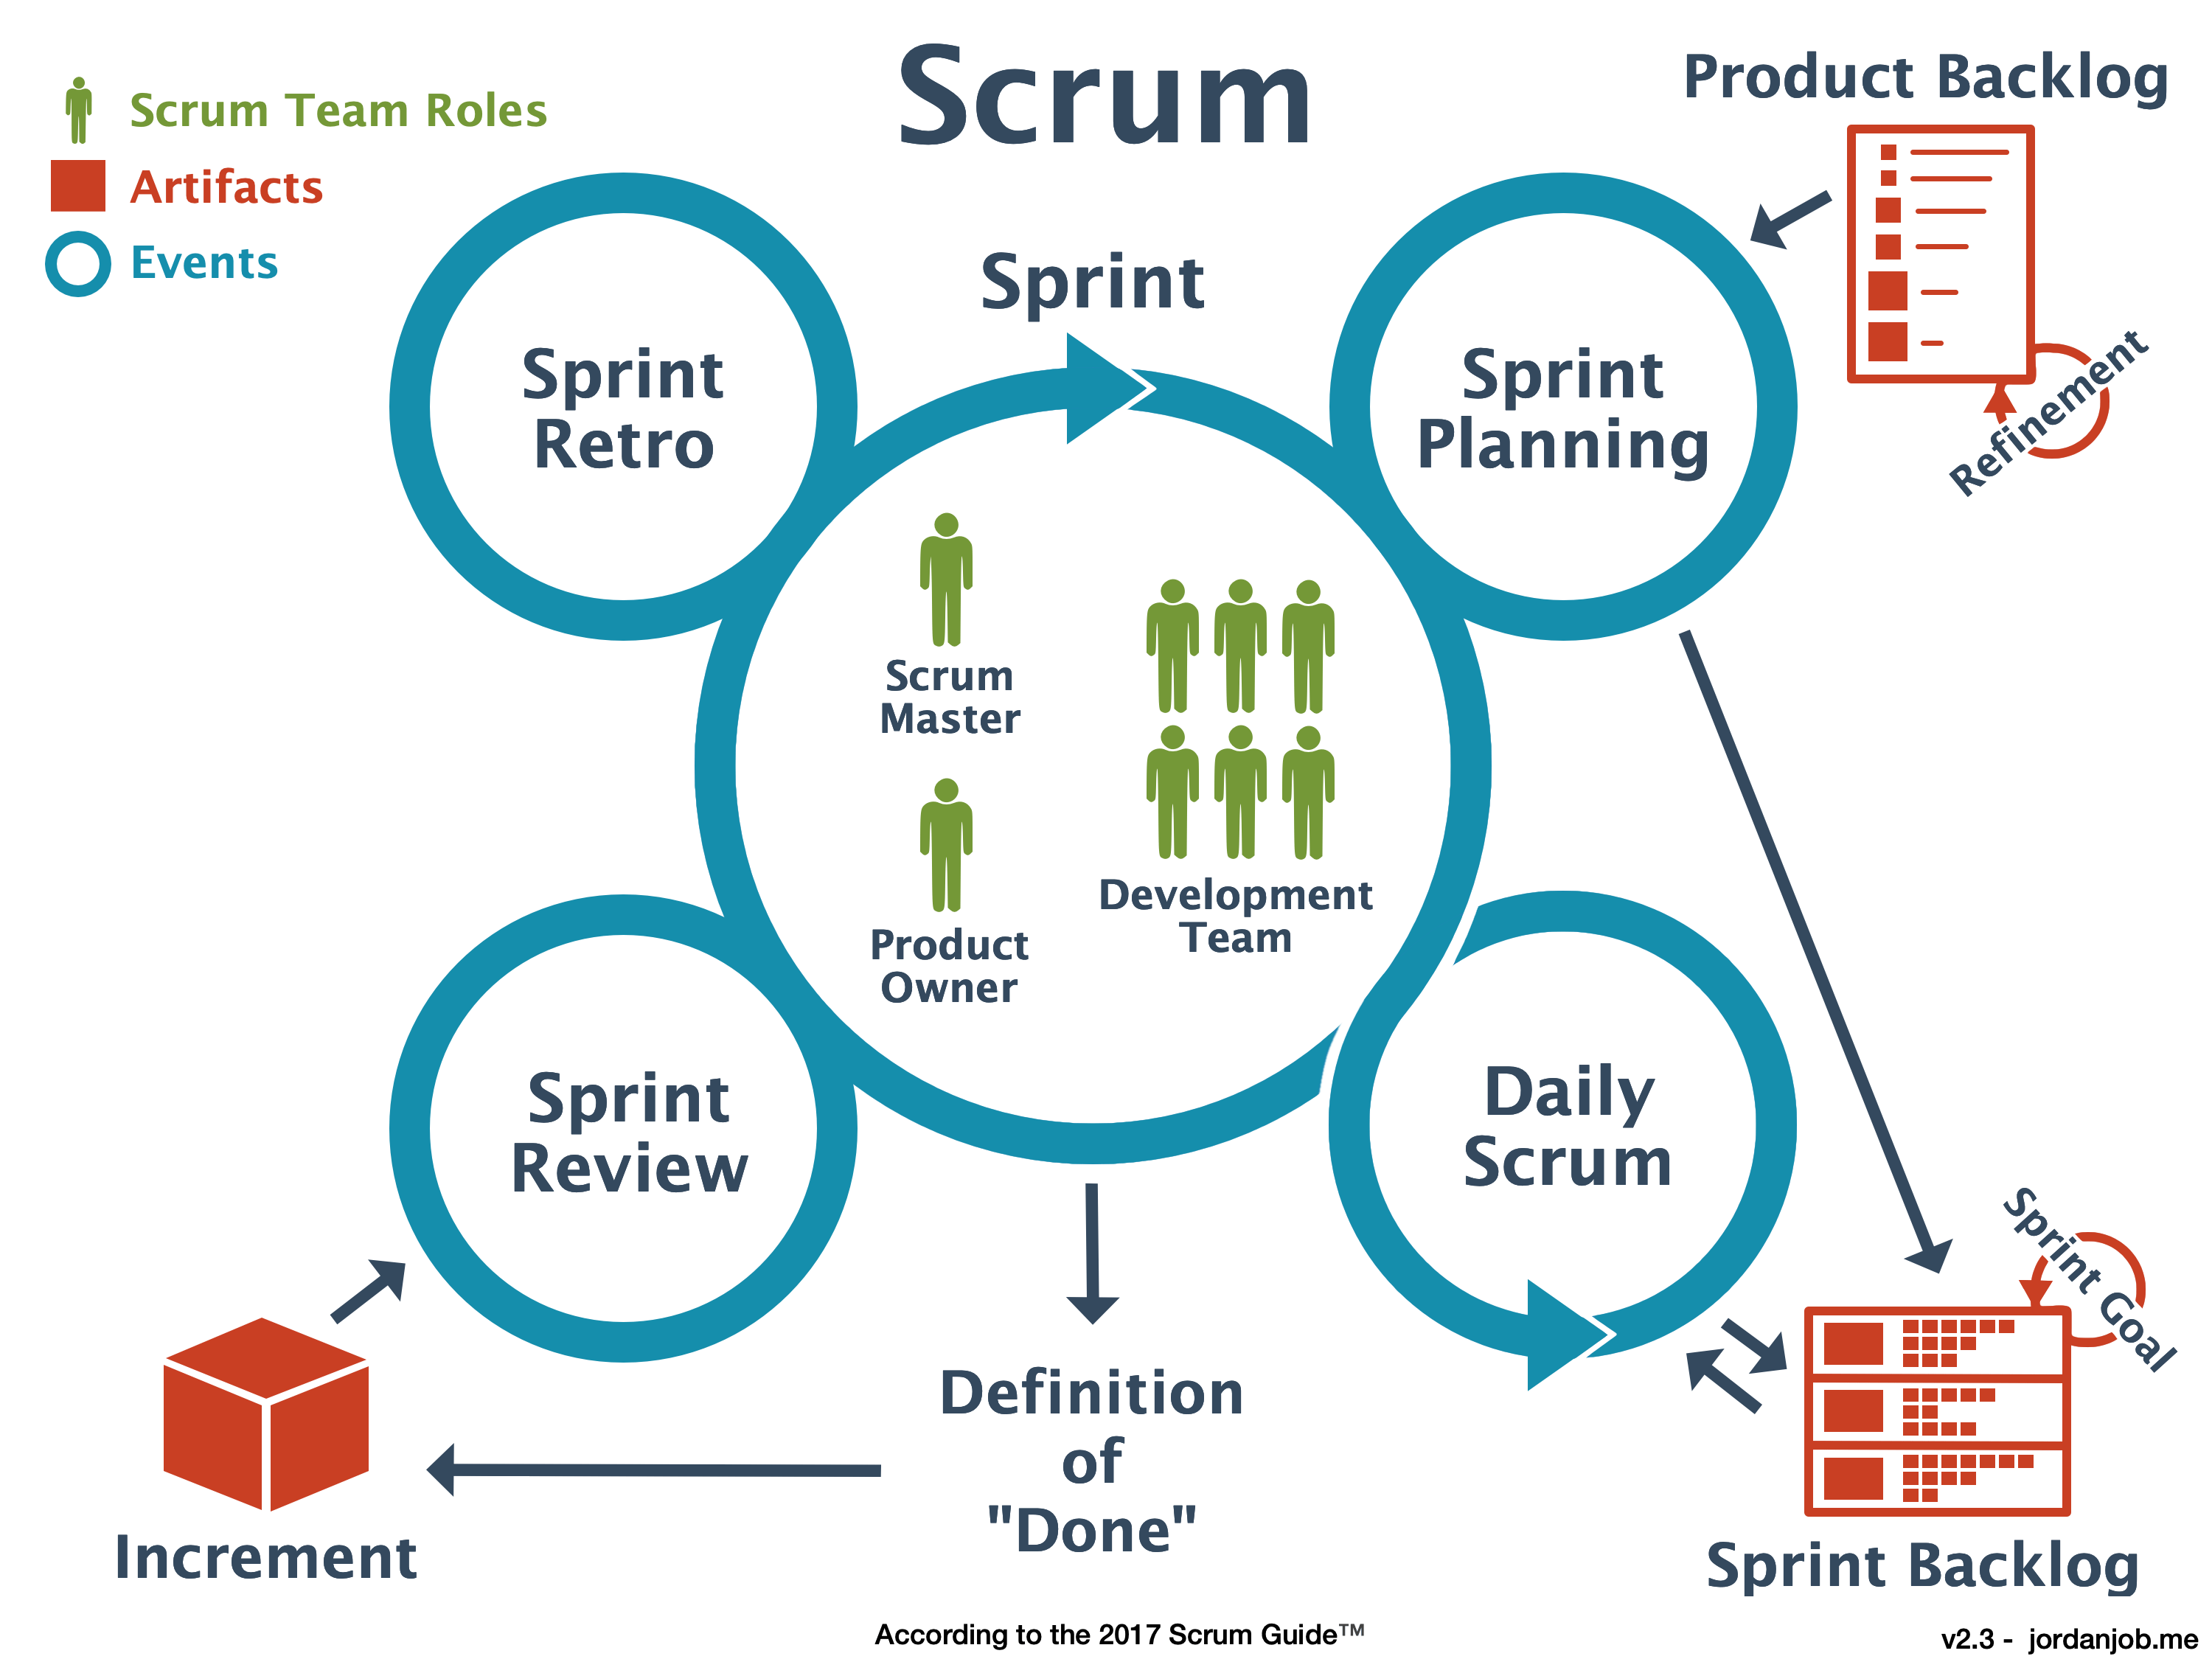
Learning 3 | My takeaways
Key learning:
Importance of business analysis, agile methodology and scrum in software development.
Key takeaway:
Business analysis, agile methodology and scrum are highly useful for planning and organizing software development clearly.
How do I personally see this concept implemented in the Energy sector:
Quick, clear and planned approach software development using scrum and agile while leveraging business analytics results can prove immensely beneficial.
o

Slide 7

Relevance of learnings for my organization

Slide 8
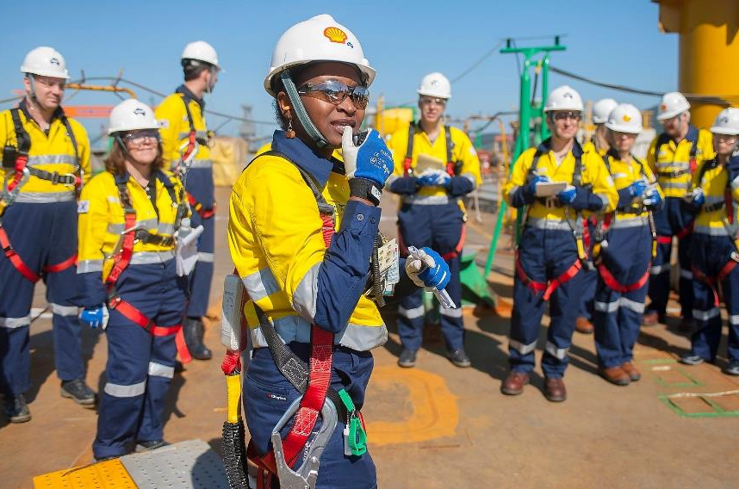
Learning 1 | Relevance for Shell
How I feel Shell implements this learning:
Shell allows employees to work in teams that collaborate closely and support all members. Each member feels heard and seen and ensures the others also feel the same. Each member learns from the skills of the others and they can combine their strengths to become a high performing team.
How I feel Shell benefits from this learning:
Through the combined skills of the team, projects are completed on a quicker schedule and with an enhanced output. Workload is divided and employees do not feel pressured.

Slide 9
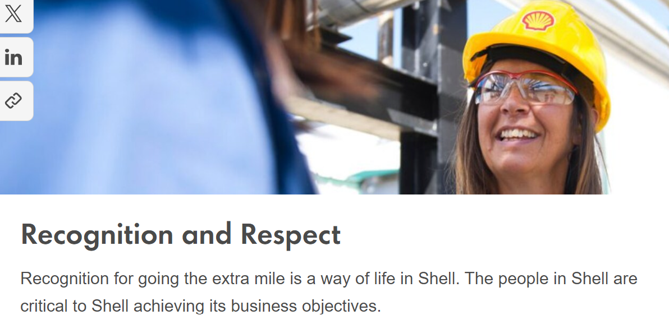
Learning 2 | Relevance for Shell
How I feel Shell implements this learning:
One of Shell’s core values being Respect for others, Shell ensures that professional etiquette is followed in all meetings and calls. Stakeholders are also respected and informed of decisions and changes timely, keeping them in the loop.
How I feel Shell benefits from this learning:
Maintaining professionalism is one of the key reasons behind the legacy value Shell has made for itself. People respect Shell in return for the respect they receive, thus making it a safe environment for the employees.

Slide 10
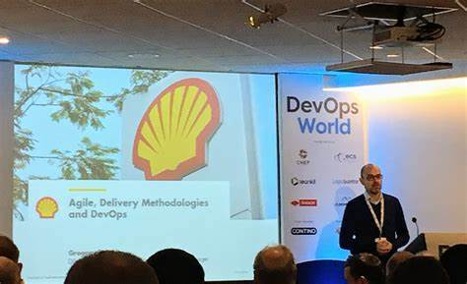
Learning 3 | Relevance for Shell
How I feel Shell implements this learning:
Shell’s IT Teams implement Scrum and Agile methodology to develop software solutions and maintain them in a quick and clear manner.
How I feel Shell benefits from this learning:
Using BA and Agile methodologies helps in streamlining the process of development and aids in team collaboration for enhanced team performance.

Slide 11

Challenges in implementing learning

Slide 12
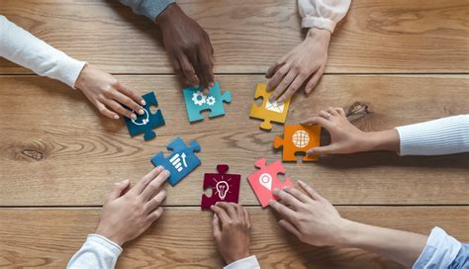
Challenge faced while implementing Learning 1
What were the challenges I faced while implementing Learning 1 and my plan to overcome them:
Getting to know new people and collaborating with them on a new task

Slide 13
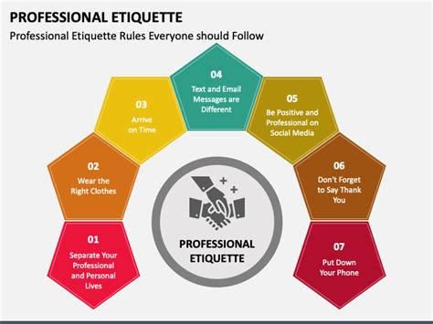
Challenge faced while implementing Learning 2
What were the challenges I faced while implementing Learning 2 and my plan to overcome them:
Knowing the boundaries in a professional environment and following the etiquette for meetings and calls when it’s easier to move in an informal direction.

Slide 14
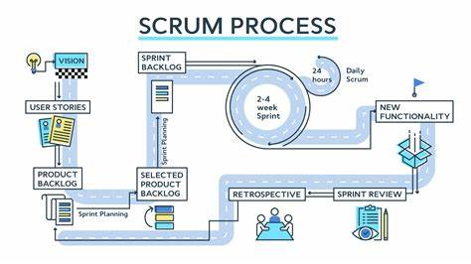
Challenge faced while implementing Learning 3
What were the challenges I faced while implementing Learning 3 and my plan to overcome them:
Relating the methodologies taught to the real life projects we’ll be working on and trying to visualize the different meetings and protocols.

Slide 15

Learning is also Fun!

Slide 16
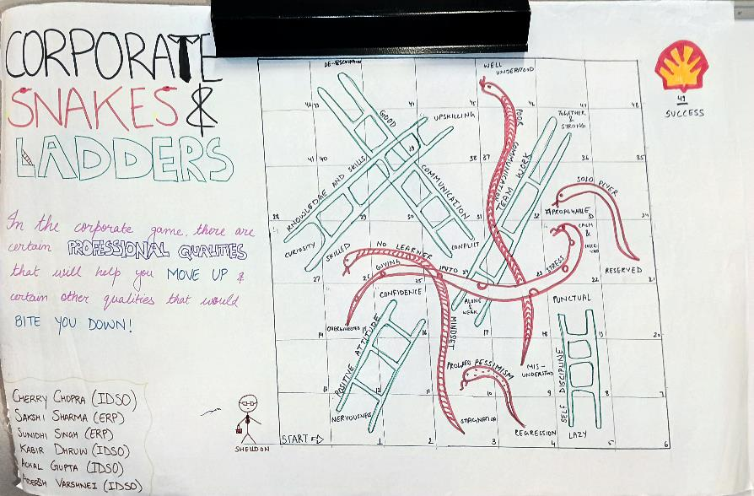
Learning is also Fun!
We collaborated in teams and participated in many activities. The activity that stood out the most to me was the poster making activity as part of understanding the qualities and attributes of a working professional. We worked in teams of 6 and created a poster. Our team created the “Corporate Snakes and Ladders”, wherein positive professional qualities would lead you moving up while any negative attribute would get you bitten down.

Slide 17
Thank You

